Slide 1
Technology Trend Analysis
Bui Xuan Nam
Date: June 03, 2024

Slide 2
Outline
● Executive Summary
● Introduction
● Methodology
● Results
● Visualization – Charts
● Dashboard
Discussion
Conclusion

Slide 3
Executive Summary
● Current Technology Usage Trend
Language
Database
Platform
Web frame
● Future Technology Trend
Language
Database
Platform
Web frame
● Demographics Survey
● Country & Gender Difference

Slide 4
Introduction
● Analyze technology trend in software and web development among developers around the world
● Purpose of this Analysis
Identify the top programming languages, database, platform and web frame skills in demand
Identify skill requirements for future
Identify human resource gap in the industry
● Audience for this Presentation
Programmers
IT industry leaders
Computer science students

Slide 5
Methodology
● Data Collection (Sources)
Stack overflow developer 2019 survey
GitHub job postings
Programming languages annual salary
● Data Wrangling
● Data Exploration
● Data Cleaning
● Data Visualization
Python matplotlib & turtle
IBM Cognos
● Presentation

Slide 6
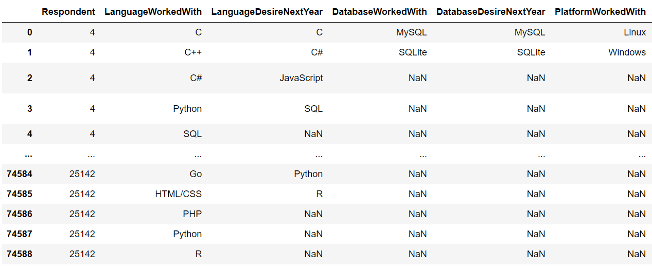
Results

Slide 7
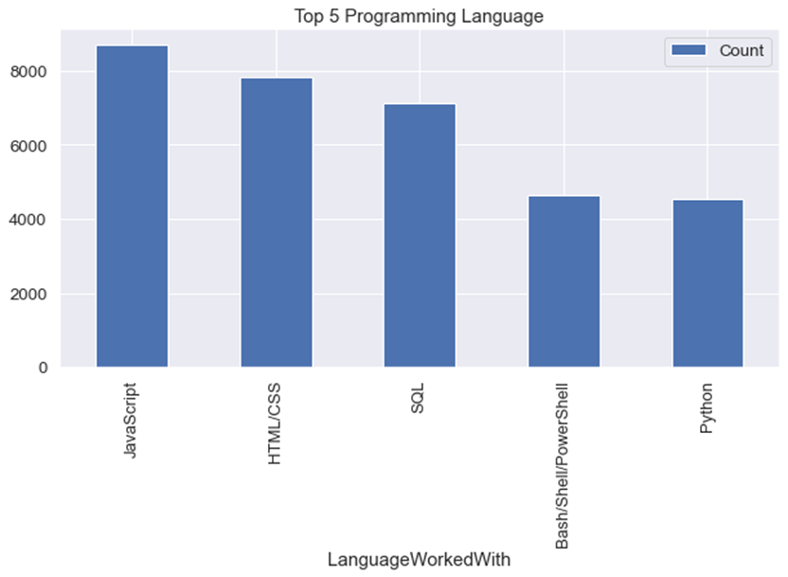
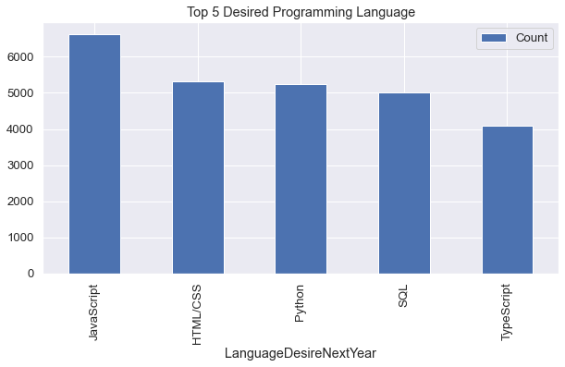
Programming language trends
Current Year
Next Year

Slide 8
Programming language trends
JavaScript is top trending language in the world
Python and TypeScript are becoming more and more popular
● HTML/CSS and SQL still has great portion in language usage trend

Slide 9
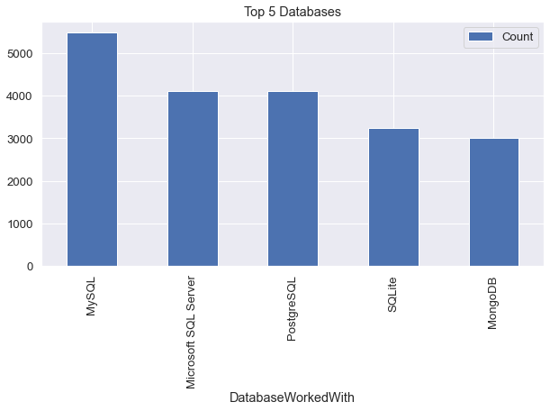
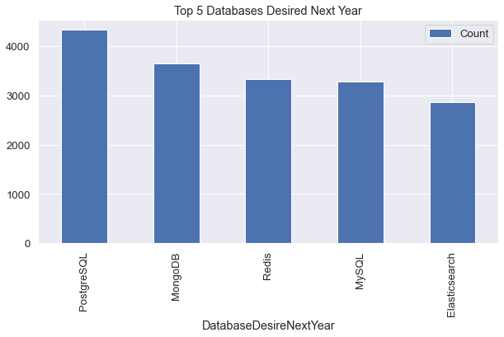
Database trends
Current Year
Next Year

Slide 10
Database trends
Fingdings
MySQL is the most popular database
There are still a lot of companies using Microsoft SQL Server
MongoDB and Redis are the most favorable NoSQL database

Slide 11
Database trends
Implications
Open-source databases like MySQL are still preferable
Software development and Big Data technology still requires SQL
NoSQL databases will make an impact for relational databases

Slide 12
Dashboard
Link at Github
https://github.com/BXNam/Dashboard

Slide 13
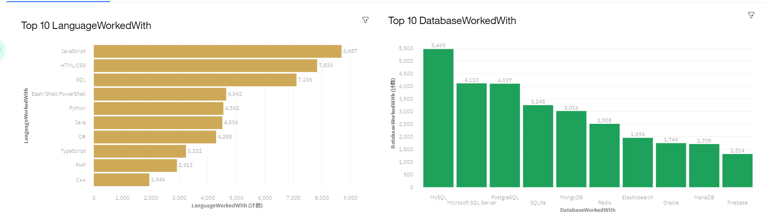
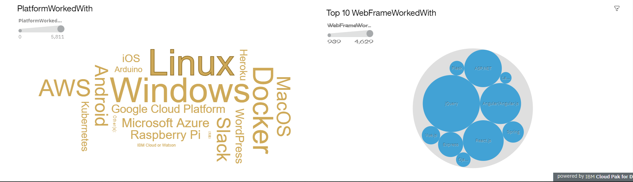
Current technology usage

Slide 14
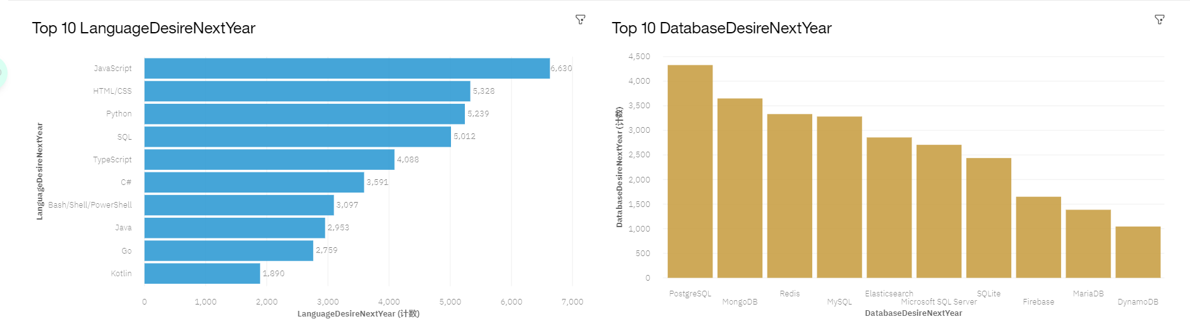
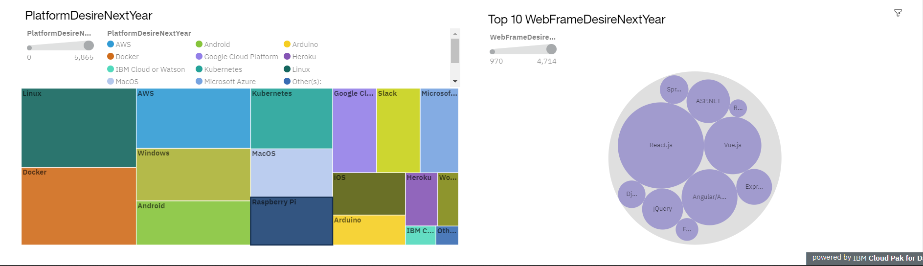
Future technology trend

Slide 15
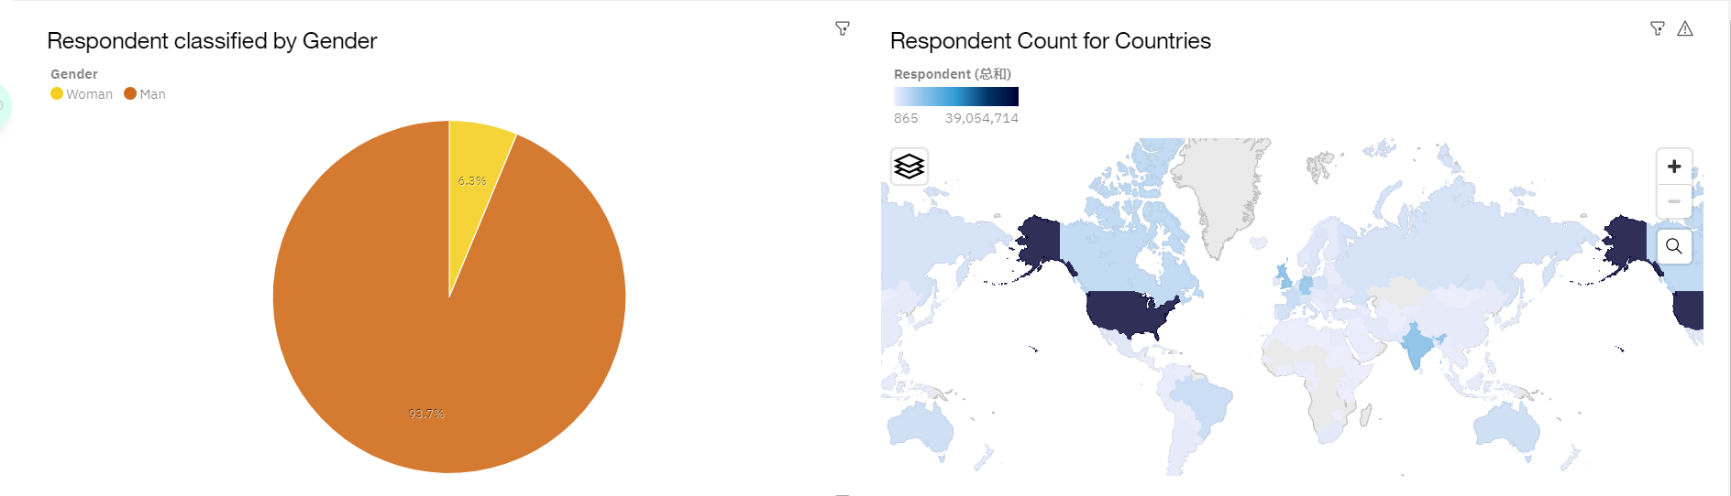
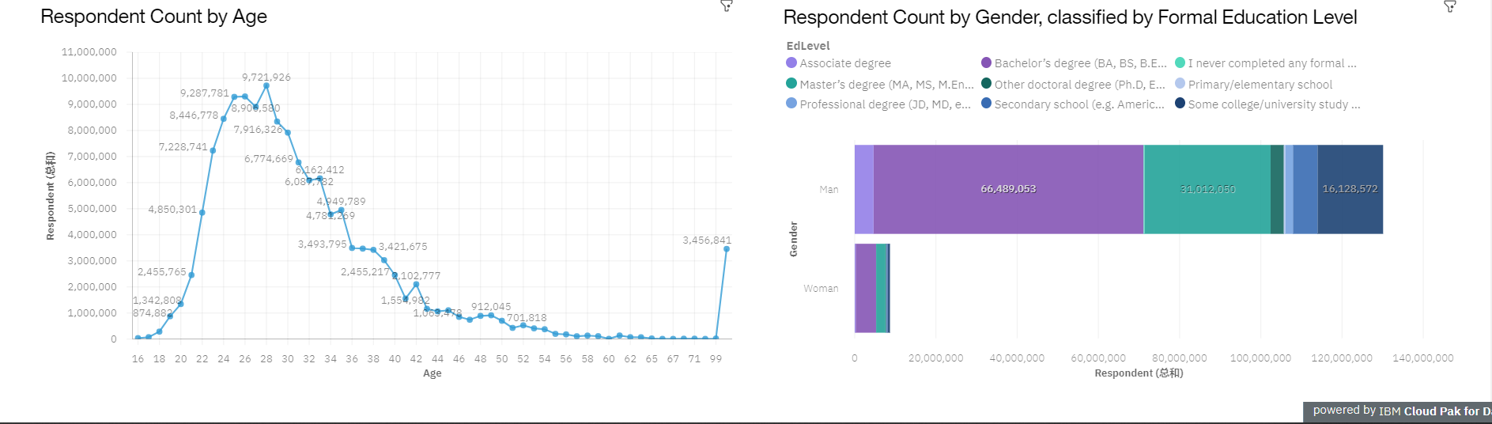
Demographics

Slide 16
Discussion
● Technology Usage Trend Now and Future
● Gender, Age and Education Discrimination in IT Industry

Slide 17
Conclusion
● Technology Trends
● Programming Languages, Database, Platform and Web frame Trends
● Demographics Trends
● Gender and Education
● Programming Languages Trends and Salary Trends

Slide 18
Overall findings & implications
Findings
● Technology trends changes every year
● USA is the top technology country
● There are extreme gender and age discrimination
● Docker and AWS are the most popular platform

Slide 19
Overall findings & implications
Implications
● Programmers should always follow the latest technology trends
● More countries should have the equal chance to be exposed to new technology
● Gender and Age should not be one of the concerns or benefits of Employment

Slide 20
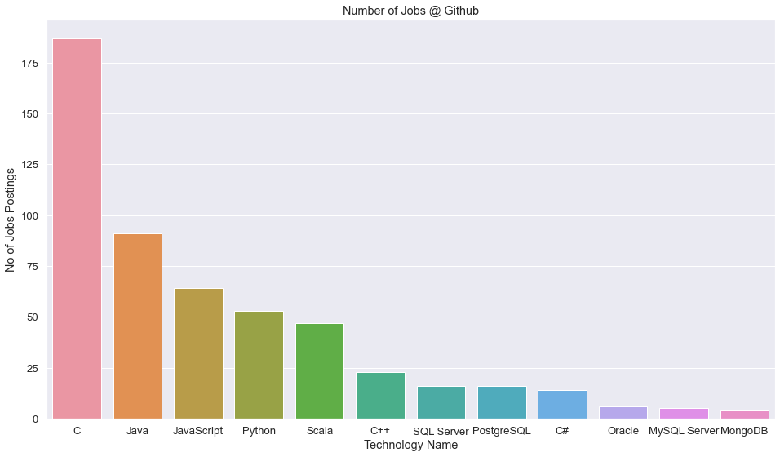
GITHUB Job postings

Slide 21
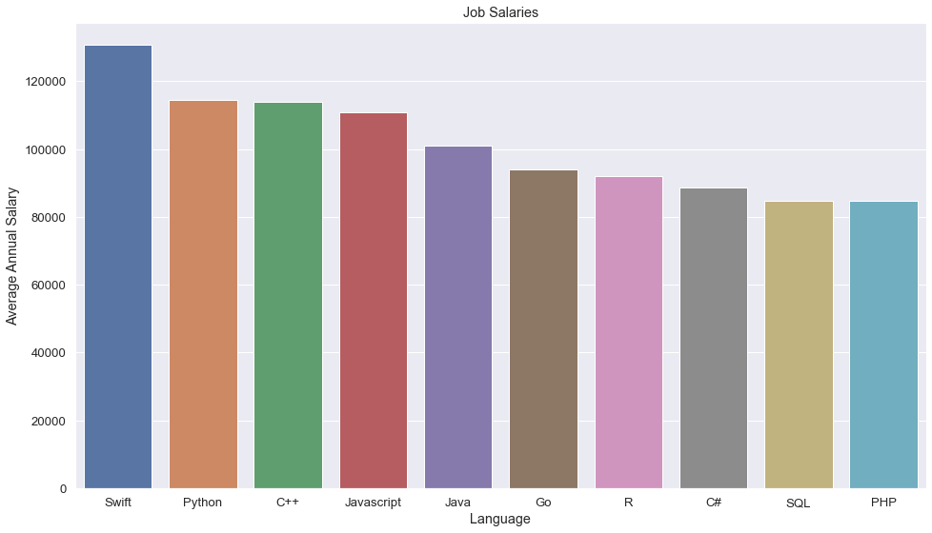
Popular languages

